Slide 1

Michelin Restaurants
Brian Goodman | Bradley Powell

Slide 2



Our Focus
One star
“High Quality Cooking, worth a stop!”
Two stars
“Excellent cooking, worth a detour!”
Three stars
“Exceptional cuisine, worth a special journey!”

Slide 3

Objective

Slide 4
Objectives
Generate a webpage that contains Michelin Star Restaurants worldwide
Create a user-friendly interactive map that provides restaurant information
Location
Price Range
Webpage URL
Provide form-search for desired locations and restaurants

Slide 5
Data collection

Slide 6
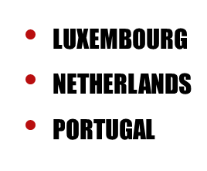
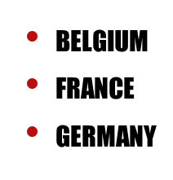
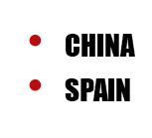
KAGGLE and the Michelin Guide
Kaggle Collection of Michelin Star Restaurants Internationally
Excludes:
Italy
Japan
Switzerland
Web scrape directly from Michelin Guide Website
Extract Restaurant name, price range, and URL
Michelin may not list all qualified restaurants

Slide 7
Visualizations
webpage

Slide 8
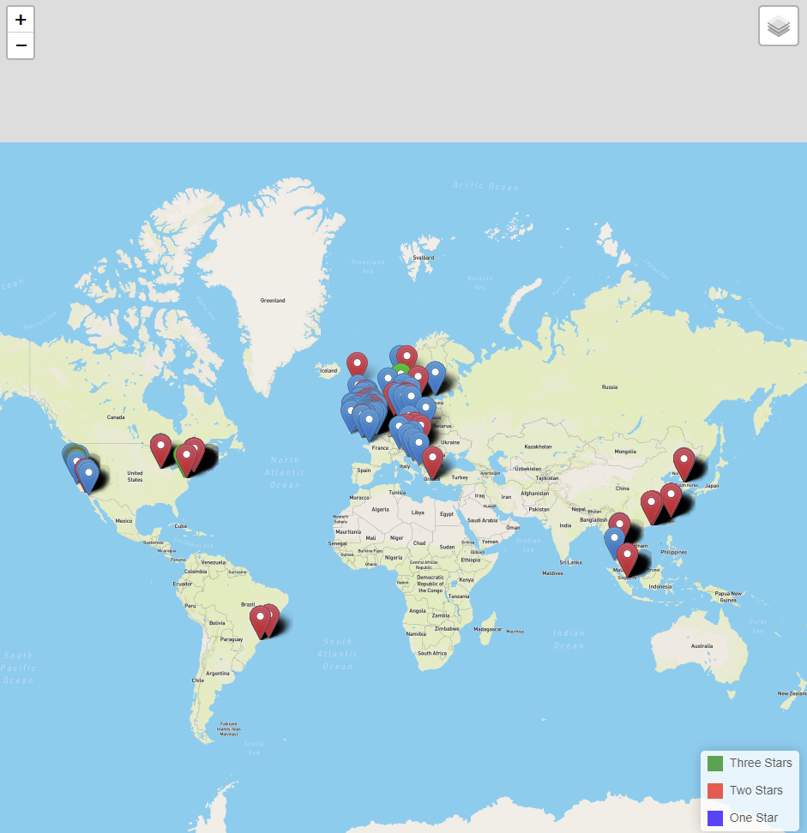
Map
We have a scalable map containing all Michelin restaurants
We can toggle the map between light and dark screens

Slide 9
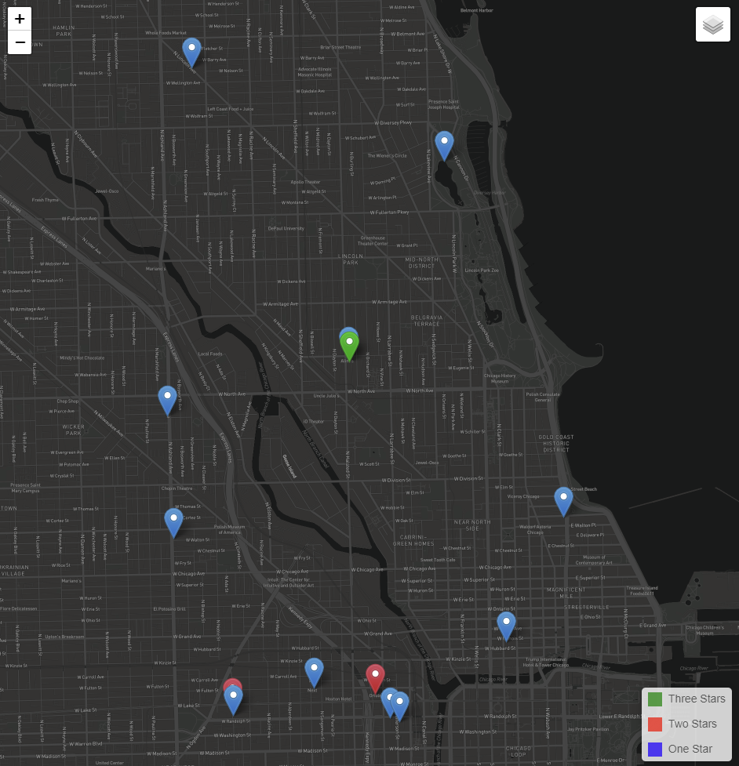
Legend reference
Each pin is denoted by its respective legend color for Michelin stars

Slide 10
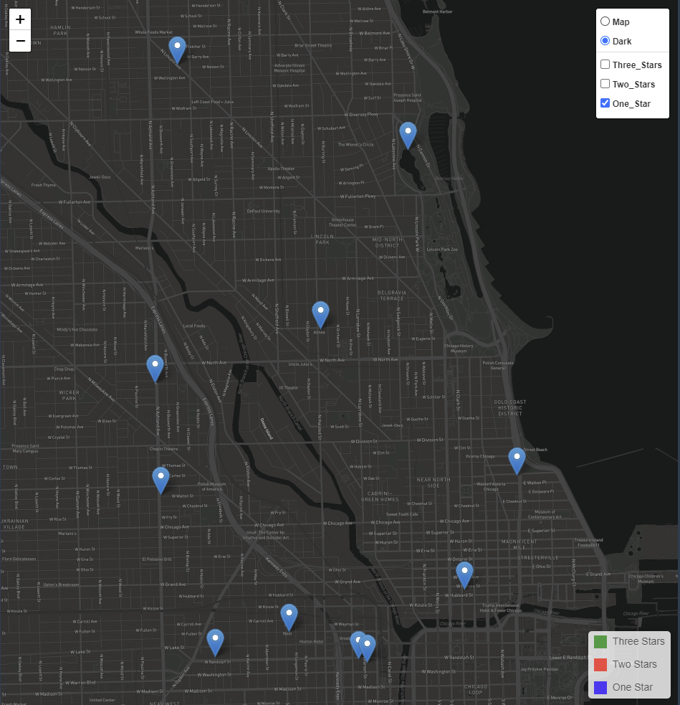
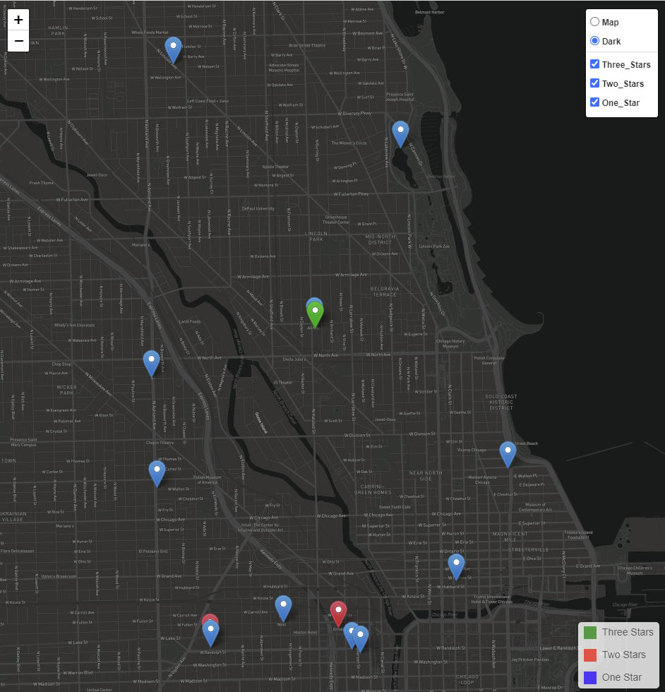
Filtering capabilities

Slide 11
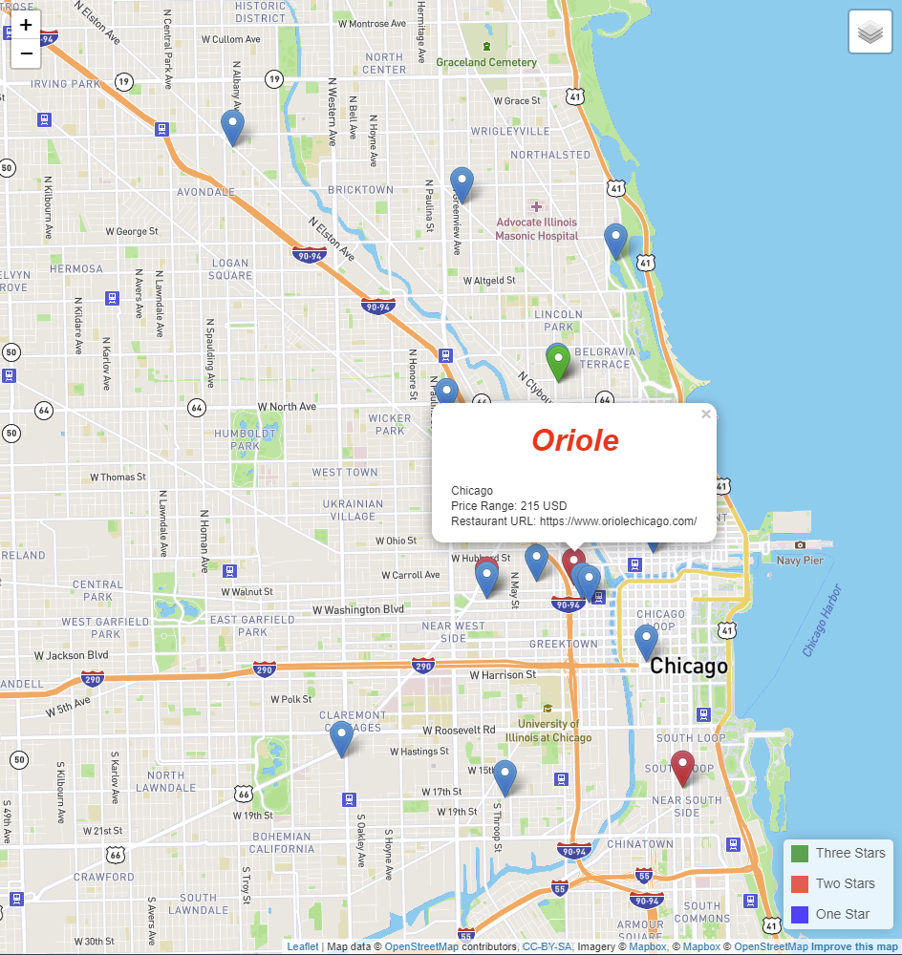
interaction
User can click on a desired pin for restaurant details
Name of the restaurant
City
Price Range
Restaurant url

Slide 12
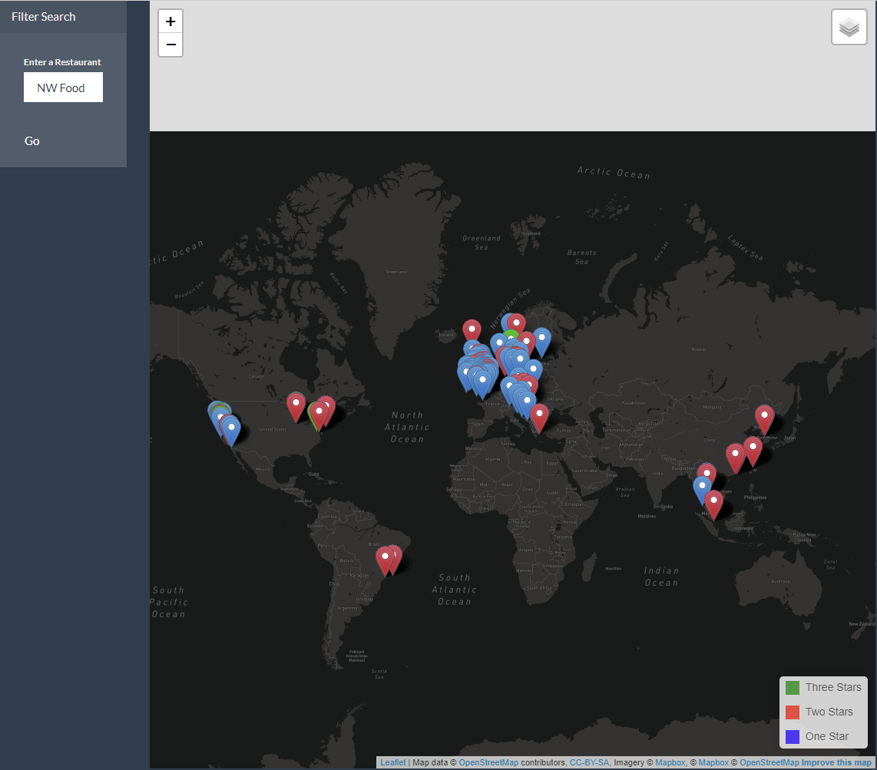
Filter search
Looking for a specific restaurant?

Slide 13
Improvements

Slide 14
Second Iteration
Improve our data collection process
Table merge wasn’t clean ( merged on names not unique IDs )
Extract location data on web scrape
Improve code that cleans data (too much hard-code)
Pure web scrape to gather all Michelin Star Restaurants
Utilize Airport Data
3-star search can find nearest airport

Slide 15
Second Iteration
Improve JavaScript utilization
Add more features to differentiate restaurant ‘cuisines’
Complete filter search capabilities
Enhanced scalability with map interaction
World → Country → City
with respective restaurant breakdown charts

